Slide 1
Data management in r: Part II

Slide 2
Learning objectives:
By the end of this lesson, learners will learn and apply the following skills in R:
Joining and de-duplicating data
Working with dates using base R and lubridate
Filtering data
Data visualization in R using geoms, facets, labels and themes to create customized outputs
Using ggplot2 to create an epidemiological curve

Slide 3
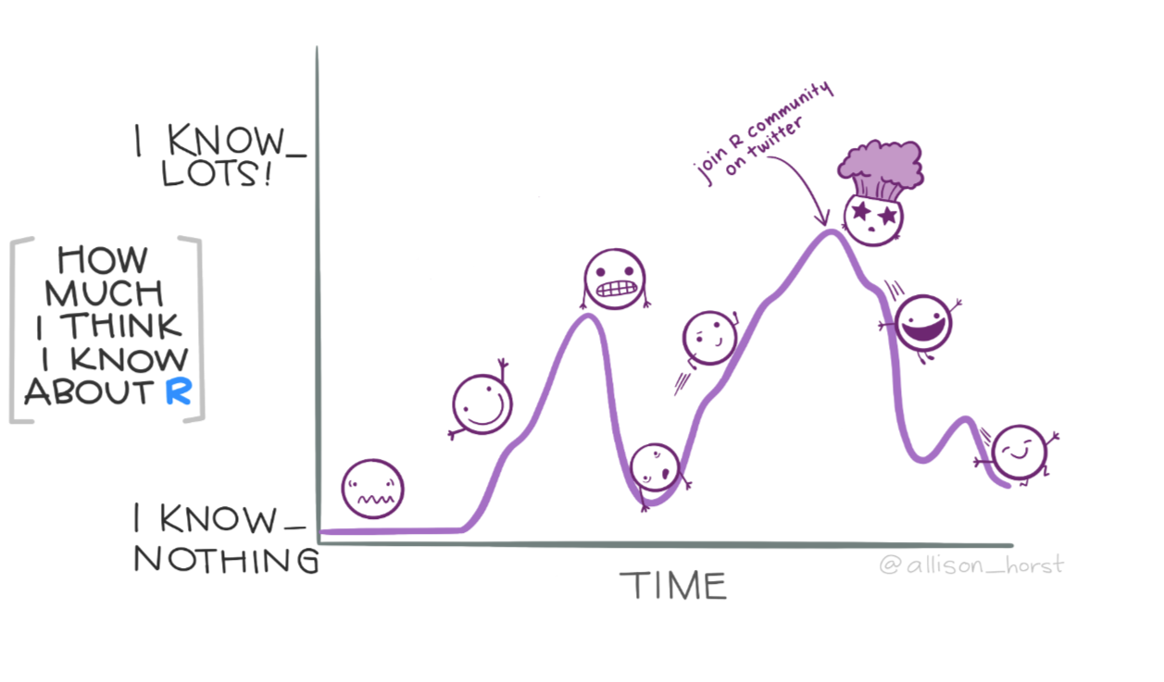

Slide 4
Getting set up

Slide 5
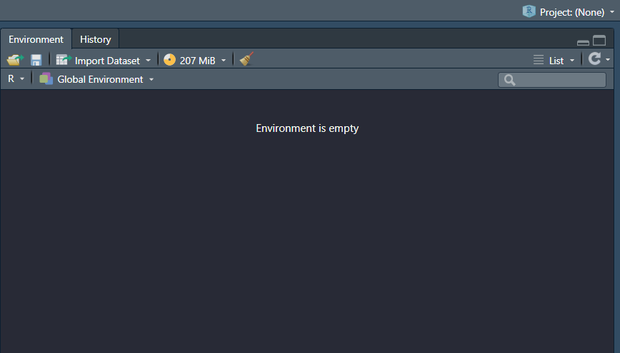
Setting up your R-pROJEct
Make sure you are working in your R-project from last week
If this says ‘Project: (None)’ then you are not working in an R-project

Slide 6
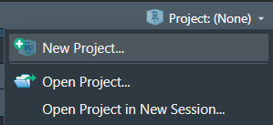
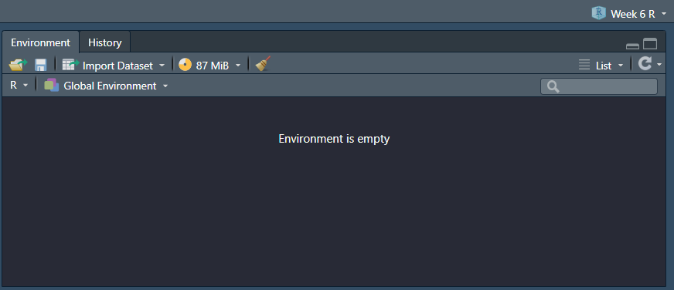
Setting up your R-pROJEct
Click the drop down arrow, select ‘Open Project’ and open the project you worked out of last week

Slide 7
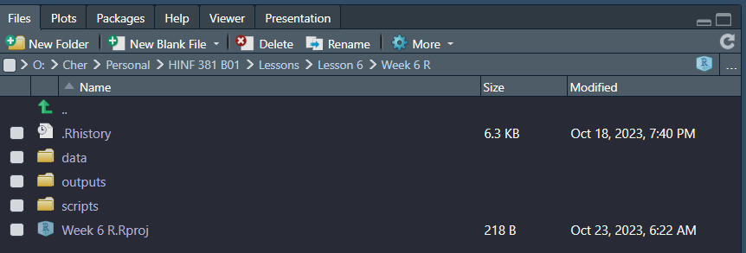
Setting up your R-pROJEct
Download the “Week 8 Exercise” R script from Brightspace and save it in your R project scripts folder

Slide 8
Review: operators

Slide 9
using the ‘assignment operator’ and ‘pipe operator’ to clean data
<-
“assignment operator” – used to assign values to an object in R
Changes will not be made to objects unless you use an assignment operator
“pipe operator” – read as ‘and then’
Used to chain or ‘pipe’ commands together
Part of the `magrittr` package which is included in the `tidyverse` package
%>%

Slide 10
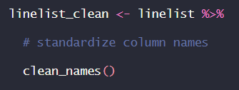
using the ‘assignment operator’ and ‘pipe operator’ to clean data
“Assign (<-) the values from ‘linelist’ to ‘linelist_clean’ and then (%>%) apply the clean_names() function

Slide 11
Joining data

Slide 12
joining data
Joining data is a common task when working with multiple data sets
For example, you may have Case ID in one data set, and the corresponding data for each Case ID in a separate data set – you can use joins to combine both data into one data frame
Joining data in R is similar to the VLOOKUP function in Microsoft Excel (Week 2)

Slide 13
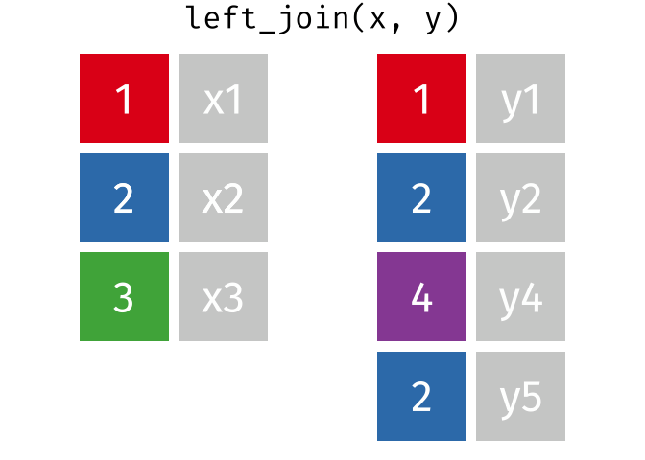
left joins
When using a left join, you are matching data to the first data frame
Data that does not match the joining column in your first data frame will not be retained
Image from: https://github.com/gadenbuie/tidyexplain/tree/main/images
Syntax: left_join(test_list, test_results, by = c(“case_id” = “unique_id”)
first data frame

Slide 14
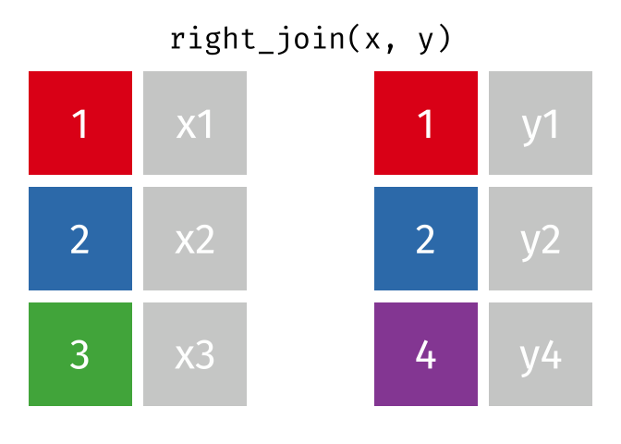
right joins
When using a right join, you are matching data to the second data frame
Data that does not match the joining column in your second data frame will not be retained
Image from: https://github.com/gadenbuie/tidyexplain/tree/main/images
Syntax: right_join(test_list, test_results, by = c(“case_id” = “unique_id”)
second data frame

Slide 15

inner joins
When using an inner join, you are matching data from both data frames
Data that does not match between both data frames will not be retained
Image from: https://github.com/gadenbuie/tidyexplain/tree/main/images
Syntax: inner_join(test_list, test_results, by = c(“case_id” = “unique_id”)

Slide 16
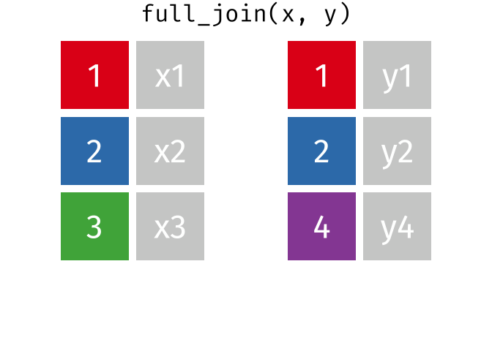
full joins
When using a full join, you are matching data from both data frames while retaining non-matching data
Data that does not match between both data frames will be retained
Image from: https://github.com/gadenbuie/tidyexplain/tree/main/images
Syntax: full_join(test_list, test_results, by = c(“case_id” = “unique_id”)

Slide 17
Summary
Left joins: keeps all rows in the first frame, drops rows in the second frame that do not match
Right joins: keeps all rows in the second frame, drops rows in the first frame that do not match
Inner joins: keeps rows that match between both the first and second data frame, drops rows that do not match between both frames
Full joins: keeps all rows of data

Slide 18
De-duplicating data

Slide 19
De-duplicating data
Sometimes datasets may come with duplicate rows of data
It’s important to remove duplicates to avoid counting instances more than once, which may skew your results
We can use the get_dupes and distinct() functions to view and remove duplicates, respectively

Slide 20
De-duplicating data: GET_dupes
get_dupes is a function from the janitor package used to view duplicate rows in the RStudio console
Syntax: linelist %>%
get_dupes()
Will return a list of rows that are 100% identical across all columns
Syntax: linelist %>%
get_dupes(-unique_id)
Will return a list of rows that are 100% identical across all columns, ignoring unique_id
Syntax: linelist %>%
get_dupes(birth_date, name)
Will return a list of rows that are 100% identical across the birth_date and name columns

Slide 21
De-duplicating data: Distinct()
distinct() is a function from the dplyr package used to remove duplicate rows in a dataset
Syntax: linelist_clean <- linelist %>%
distinct()
Will de-duplicate rows; only unique rows will remain in your dataset
Will de-duplicate rows; only unique rows of name and birth_date will remain in your dataset. NOTE: the only columns that will remain in your dataset are ‘name’ and ‘birth_date’
Syntax: linelist_clean <- linelist %>%
distinct(name, birth_date)
Syntax: linelist_clean <- linelist %>%
distinct(name, birth_date,
.keep_all = TRUE)
Will de-duplicate rows; only unique rows of name and birth_date will remain in your dataset. NOTE: adding .keep_all = TRUE will retain all columns in your dataset

Slide 22
Working with dates

Slide 23
Working with dates
Dates are often stored as date time in R and are formally referred to as POSIXt, POSIXct and/or POSIXlt classes
You can check the class of a variable by viewing it in the ‘Environment’ pane or by using the base R function class()
class(linelist_clean$onset_date)
data frame
variable

Slide 24
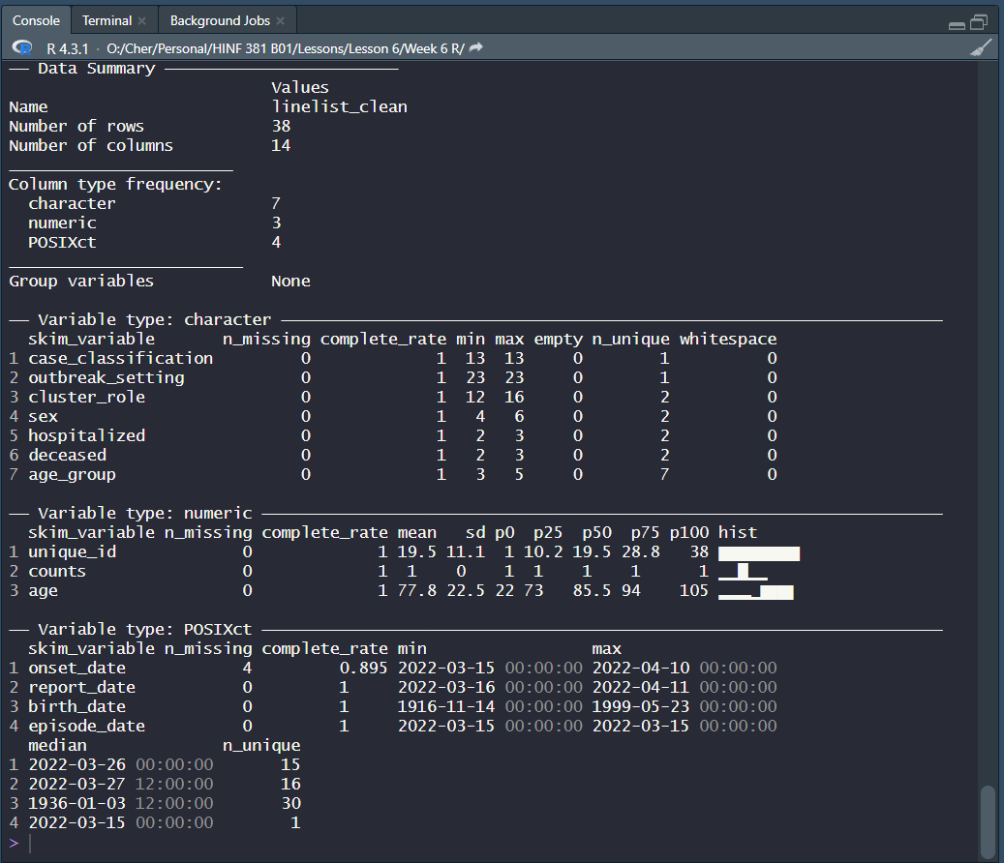
You can also use the skim() function learned in last week’s session
skim(linelist_clean)

Slide 25
Working with dates
To convert a variable to a Date class, we can use the standard base R function as.Date()
When converting a date, use the format = argument to tell R the current format of your date
R will convert dates to the standard date format, YYYY-MM-DD

Slide 26
Working with dates: example
We want to convert ‘onset_date’ from POSIXct format to a date format
onset_date is currently formatted as: YYYY-MM-DD, so we would write:
linelist_clean <- linelist_clean %>%
mutate(onset_date = as.Date(onset_date, format = “%Y-%m-%d”))
Tip: When using the format = argument, be sure to use the correct date-part separator (eg. /, -, or space) that is used in your current date format

Slide 27
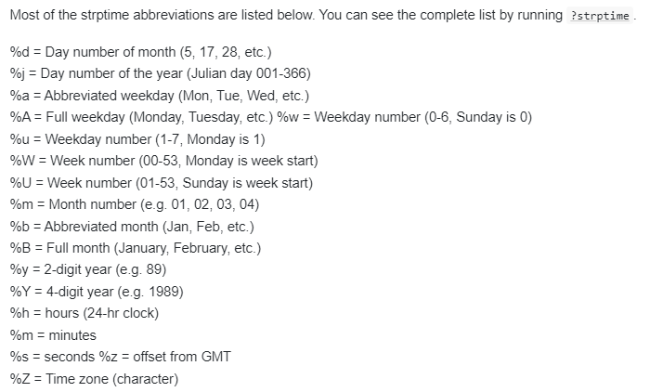
Working with dates
Source: Epi R Handbook
For more information on date conversion, run ?strptime in the RStudio console

Slide 28
Working with dates: lubridate
We can also use the lubridate package (from tidyverse)
lubridate was designed to make working with dates more simple than the base R function as.Date()
Add lubridate to the top of your script (as part of the pacman::p_load command) and re-run the pacman::p_load command to install and load lubridate (see next slide for example)

Slide 29
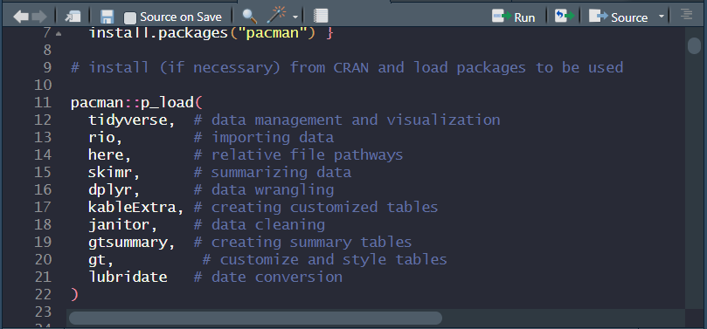
Working with dates: lubridate
Step #2: Run from here to the bottom of your pacman code (line 22 in this example):
Step #1: Add this line of code

Slide 30
Working with dates: lubridate example
We want to convert ‘episode_date’ from POSIXct format to a date format
episode_date is currently formatted as: YYYY-MM-DD, so we would write:
linelist_clean <- linelist_clean %>%
mutate(episode_date = ymd(episode_date))
If our variable was in MM-DD-YYYY format, we would write mdy here instead

Slide 31
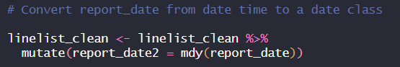
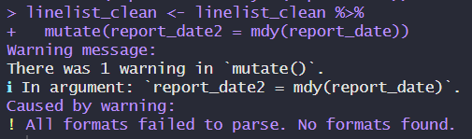
Working with dates: lubridate example
If you use the wrong date format, you will get a warning message and your resulting date variable data will be NA

Slide 32
Filtering data

Slide 33
Filtering data
We can use the filter() function from the `dplyr` package to filter data
We use this function when we want to keep certain rows in our data
Example: You want to create an object (ie. data frame) that is ‘residents’ only
linelist_residents <- linelist_clean %>%
filter(cluster_role == “Resident/patient”)

Slide 34
Filtering data: example
Assignment operator: we are assigning values from ‘linelist_clean’ to ‘linelist_residents’
New data frame name
AND THEN
linelist_residents <- linelist_clean %>%
filter(cluster_role == “Resident/patient”)
The variable we want to filter
The criteria we want to filter on

Slide 35
Filtering data
You can filter on more than one criteria by adding either of the following commands to your code:
&: (and) will keep rows that meet both criteria
|: (or) will keep rows with either criteria

Slide 36
Filtering data: Example
Example using & (and):
linelist_residents_hosp <- linelist_clean %>%
filter(cluster_role == “Resident/patient” & hospitalized == “Yes”)
Example using | (or):
linelist_severity <- linelist_clean %>%
filter(deceased == “Yes” | hospitalized == “Yes”)

Slide 37
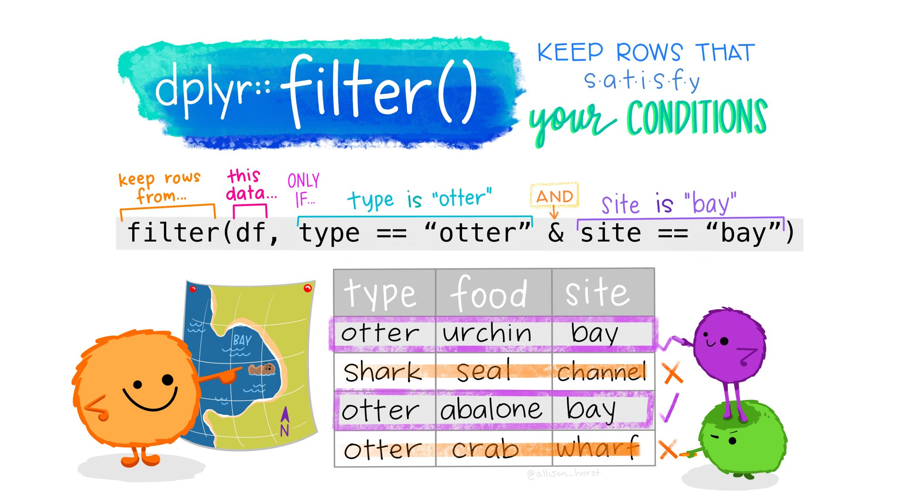
Image from: https://allisonhorst.com/r-packages-functions

Slide 38
Using ggplot2 to create an epidemiological (epi) curve

Slide 39
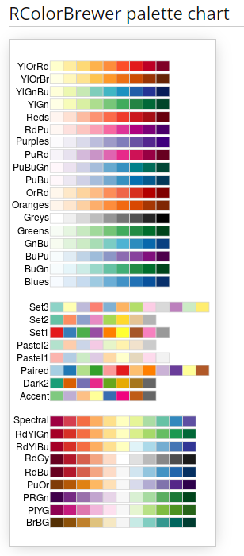
Introduction to ggplot2
ggplot2 is one of the core packages within the tidyverse package
It uses aesthetic mapping, layers, scales and faceting to create highly customized visualizations
If you are trying to create a visual using ggplot2 and are feeling overwhelmed, start with a basic chart then add on layers
Image from http://www.cookbook-r.com/Graphs/Colors_(ggplot2)/

Slide 40
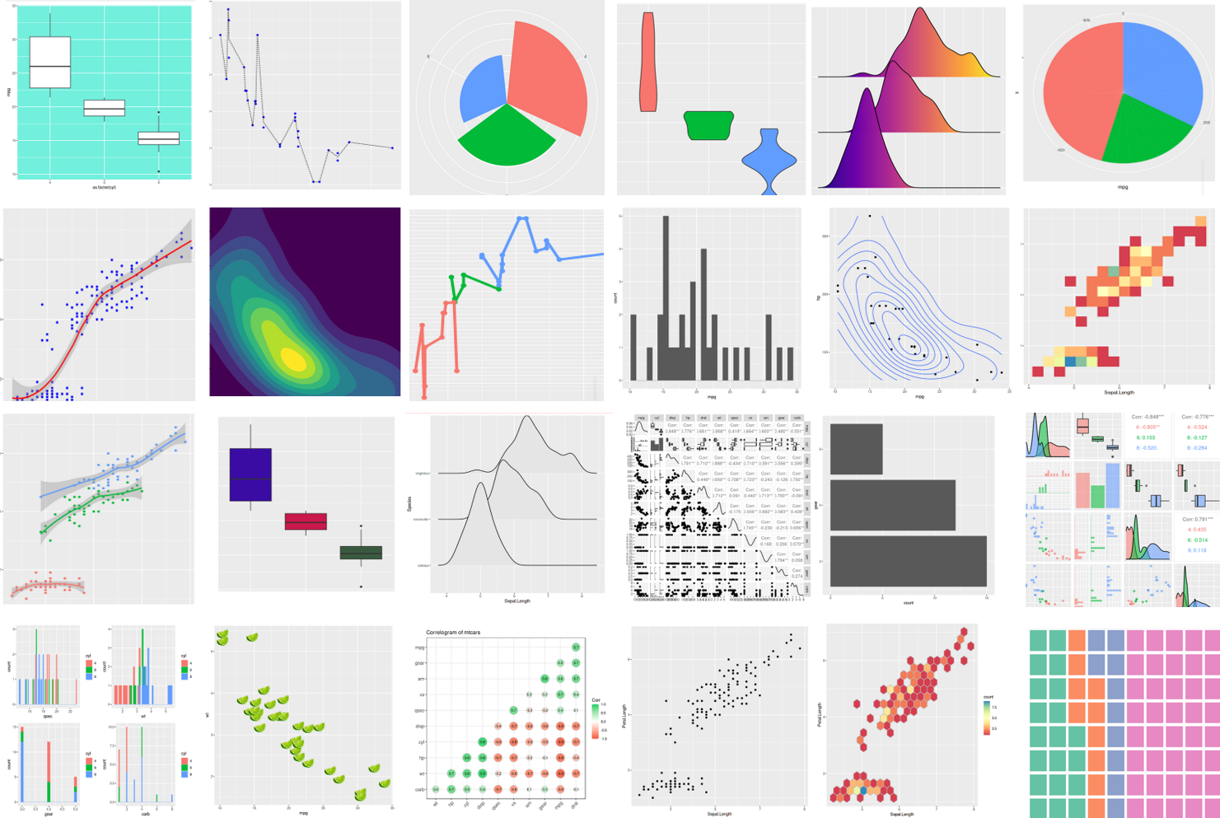
Introduction to ggplot2
Consult the online R community if you don’t know where to begin – odds are somebody has already created something similar to what you are trying to create!
Image from https://www.analyticsvidhya.com/blog/2022/03/a-comprehensive-guide-on-ggplot2-in-r/

Slide 41
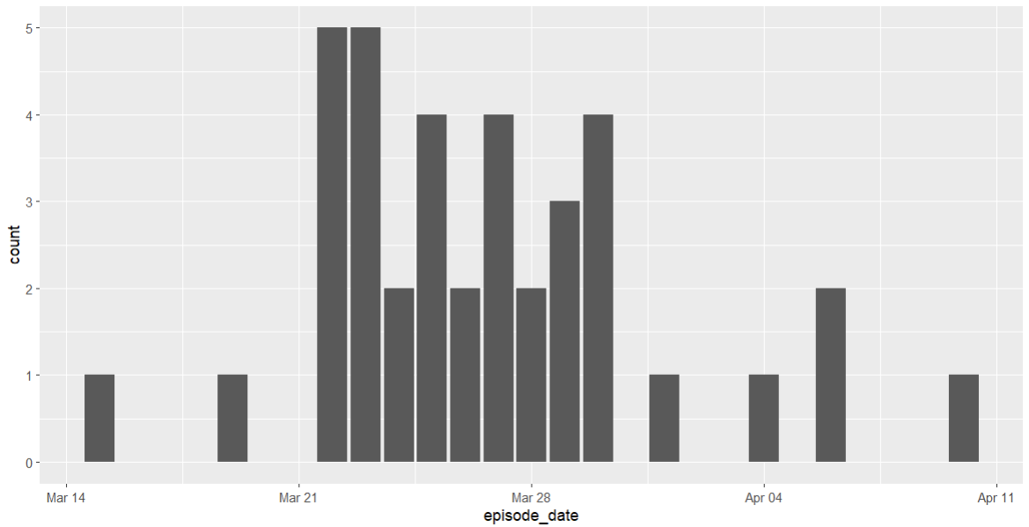
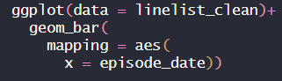
Creating an epi curve using ggplot2
All ggplot visualization code will start with ggplot(data = )
Next, put the type of visualization you want to make (in this case, geom_bar to create an epi curve)
Use the mapping function to assign aesthetics

Slide 42
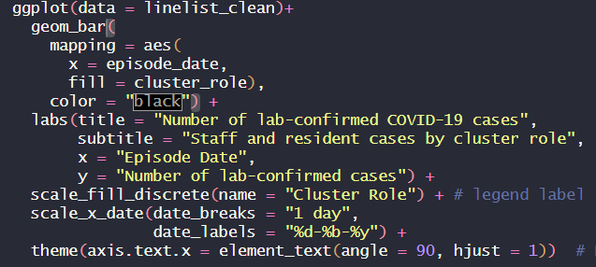
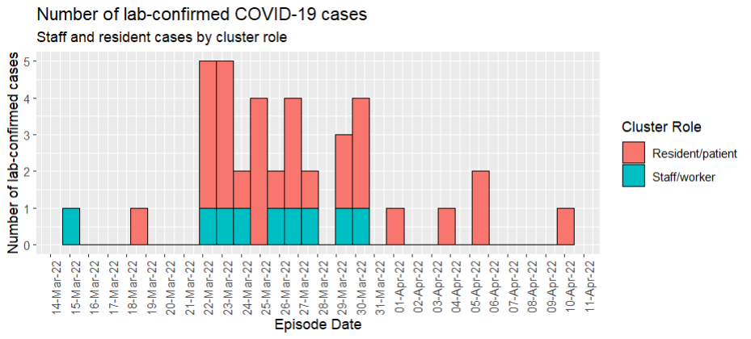
Creating an epi curve using ggplot2
The rest of your code is essentially for customizing the visualization of your output

Slide 43
Core assignment #2
Create an outbreak report using the COVID19 Elementary School Outbreak dataset
This assignment is to be completed individually
Students must submit the assignment AND their R script on Brightspace to receive credit.

Slide 44
Core assignment #2
Summary (/10): 4-6 bullet points highlighting the main points of interest covered in the report.
Summary Table (/15): Summary of demographic information (mean, min and max age; sex) and severity (ever hospitalized; deceased) for students and teachers. This table should include the total number and proportion of cases for each section.
Epidemiological Curve (/15): The number of student and teacher cases by episode date.
Learner chosen charts (2) (/10 each, /20 total): Students to choose which additional information to include in the report. These should be charts (eg. graphs) NOT tables. Hint: Use the summary table for inspiration as to what may be of interest to show in a visual.

Slide 45
Mini assignment #8
1. Complete the code in Part 1 & Part 2 of the ‘Week 8 Exercise’ script
2. In Part 3, run each section of ggplot code step by step (Step 1 – 9) and write out what is being changed and/or added in each step (write your explanation directly in R using #)
3. Submit your R script on Brightspace to receive credit for Mini Assignment #8

Slide 46
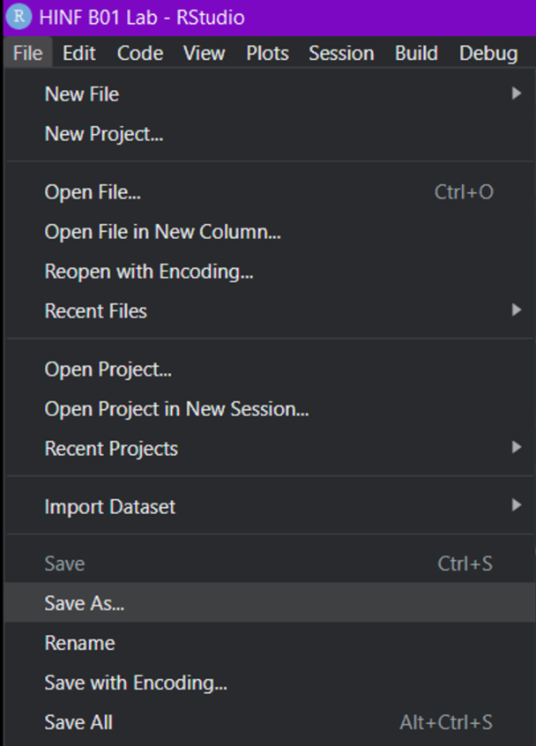
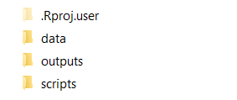
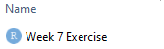
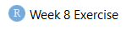
Saving your r script
To save your R script, click “File” -> “Save As…” -> “scripts” -> “Week 8 Exercise”

